Slide 1
GoSudbury! Transportation
Update to Select Board, 19 October 2021
DRAFT 09/22/2021

Slide 2
History
The Sudbury Transportation Committee was created by the Select Board to address a key feature of livable communities: transportation. A livable community is defined as …
one that is safe and secure, has affordable and appropriate housing and transportation options, and offers supportive community features and services. …Well-designed, livable communities promote health and sustain economic growth, and they make for happier, healthier residents — of all ages. http://www.aarp.org/livable-communities/net-work-agefriendly-communities/info-2014/an-introduction.html
DRAFT 09/22/2021

Slide 3
History
The Livable Sudbury initiative leverages knowledge gained from community initiatives developed around the world, including many in Massachusetts. By focusing explicitly on people of all ages rather than exclusively on older adults, Livable Sudbury is aligning its efforts with community priorities. The commitment made by the Livable Sudbury initiative to emphasize inclusion and equity in process and outcomes also reflects a laudable innovation.
Equity means that there are no disparities from intent or unanticipated outcomes in residents’ access to community opportunities. Disparity of access diminishes inclusion, which affects people’s feelings of belonging to and satisfaction with their community. The latter can result in isolation—and serious, negative, health consequences.
DRAFT 09/22/2021

Slide 4
History
Transportation gaps affect all livable domains, reducing the overall “livability” and long-term attractiveness of the town
  Lack of transportation limits social participation
  Lack of transportation affects overall well-being (domain of community and health services)
  Lack of transportation affects housing options and limits access to outdoor spaces
  Lack of transportation limits civic participation and employment
  Lack of transportation can result in segments of the town population “not feeling welcomed” (respect and social inclusion).
DRAFT 09/22/2021

Slide 5
The Current Reality
Sudbury has been described as a car-dependent “transit desert”
Because Sudbury, along with Bolton, Boxborough, Carlisle, and Stow, is classified as rural, it is very difficult to justify mass transit
Increase in senior population in Sudbury and other communities because of aging-in-place PLUS in-migration to age-restricted developments, etc.
Increase in financially vulnerable population in Sudbury, because of affordable development expansion (“Chapter 40B”) and “housing cost burden” of seniors aging-in place
Age-related increase in number of people with disabilities impacting mobility
DRAFT 09/22/2021

Slide 6
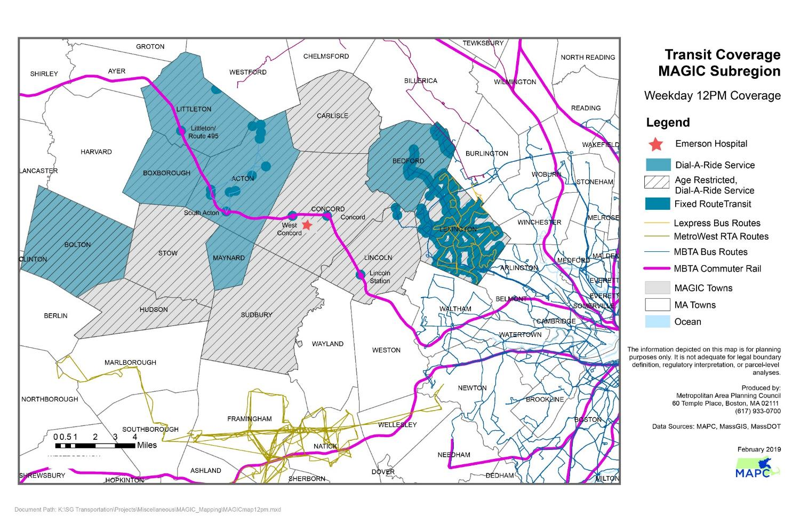
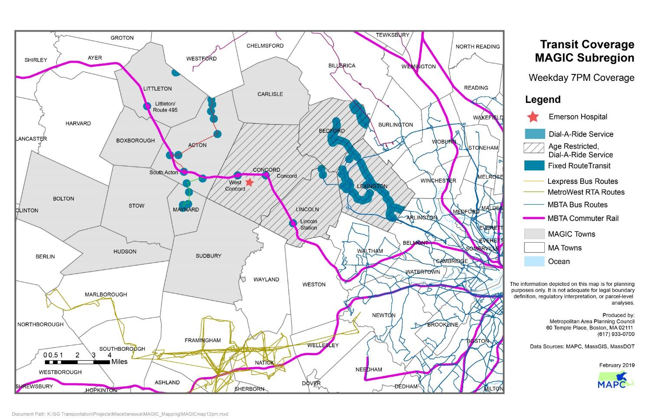
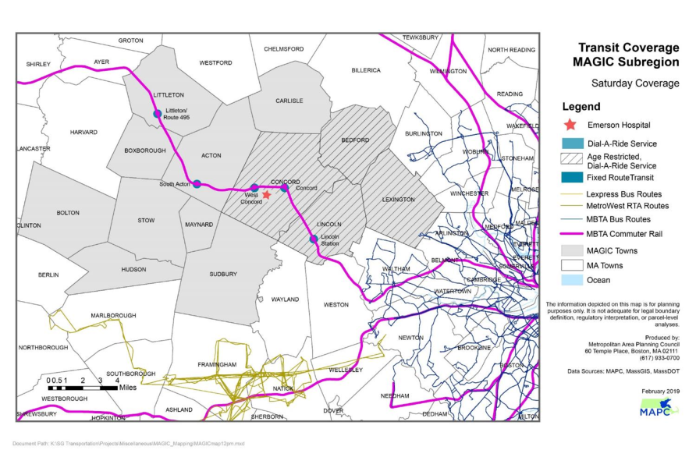
Transit Deserts (MAPC Data)
DRAFT 09/22/2021

Slide 7
Initiatives Underway
$80,000 Community Compact Cabinet Grant (2019): “Making the Connections”
    Sudbury, Acton, Bolton, Concord, Maynard and Stow; using microtransit to supplement CoA and RTA services (in process)
$23,050 MAPC COVID-19 Emergency Taxi Grant 1 (2020)
  Sudbury contracted with Tommy’s Taxi and JFK Transportation (concluded 2.28.21)
$100,000 MAPC COVID-19 Emergency Taxi Grant 2 (2021)
  Sudbury, Concord, Maynard, Stow contracting with Tommy’s Taxi and JFK Transportation (in process)
$10,000 GoSudbury! Uber Rides Program Pilot (2021)
  Sudbury contracting with Uber as part of Making the Connections
DRAFT 09/22/2021

Slide 8
Focus of Initiatives
Current focus for all transportation initiatives is meeting priority needs. For Sudbury, these are defined as transportation to: healthcare and social services, shopping, community resources, and work.
Residents most in need of such transportation include those:
Over age 50 years,
With disability (temporary or permanent)
Veterans
Financially vulnerable.
DRAFT 09/22/2021

Slide 9
Data Collected
Here we can put # of rides, cost per ride, etc. Take right from one of Alice’s great updates
Cost of taxi vs Uber – important to highlight!
Where were people going -- transition to the graphics on next page
DRAFT 09/22/2021

Slide 10
Data Collected
Visuals here – either Uber’s dashboard graphics or the google maps w/ pins…e.g. highlight Route 20 corridor
Absolutely, and we need to “show” data on taxi usage, especially during first grant—such as registrants with disability (see my Excel excerpt sent to Doug), medical appointments (as you noted, when few other options were available during COVID), and rider feedback (very important to show we collect this). We can discuss together…
We want the SB to have a “balanced” view of what we’re doing and not fixate ☺ on the low cost of Uber.
DRAFT 09/22/2021

Slide 11
Accomplishments to Date
Under Accomplishments I think it is important to highlight the tie of transportation to physical health (talk about, for example, trips to dialysis) as well as mental health
Also we were able to provide rides during Covid when other options were not available!
Both excellent points, although prior slide expanded may supplement what we need to put on this slide.
DRAFT 09/22/2021

Slide 12
Lessons Learned
Successes
  We shouldn’t skimp here! Celebrate what we’ve done
  Agreed, and we need to be clear in how we define success. I believe we reached and are reaching most of the most needy (frail, disabled, older, poor). We provided a huge number of rides in comparison to what was available. We demonstrated what the priority needs are, and who needs them most.
Sudbury as a Model/Leader
  Here I think we should mention that others in the Region *and State* are looking to what we are doing and modelling their behavior after ours
  Lead Community…. I like this, especially after hearing that we were among a relatively small number of communities doing the first MAPC grant. And, we are a model for a rural-suburban region with multiple RTAs and little MBTA services. The challenge is a national one: public/mass transit cannot be efficiently expanded to areas like ours, and communities like us are pushed to demonstrate what can work (e.g., Newton with Via, Lexington, etc.)
Tie to Livable Sudbury survey – I think we can show that our data validates it!
  I think we can prove there is a need! Thank you for keeping this front and center!
DRAFT 09/22/2021

Slide 13
Lessons Learned
Pitfalls/Gaps
  We address ONLY the top priority destinations for the most needy. Transportation is important for so many more residents. The Livable Sudbury assessment found:
Transportation is identified as crucial by a wide range of stakeholders:
  Families with children under 18 years
  Residents age 60+
  Residents of all ages with a participation limitation
  Residents of all ages who are not financially secure.
  Need to get Disability much space here; yes, and repeat the data we have on registrants with disability (undercounted, of course)
  Dependence on outside funding (we had to shut down the Taxi program); equally as important, we spent twice as much as MAPC awarded, and we should be proud of that
  Town Staff scattered – Sr Center, Planning Office, Social Worker; emphasize range of stakeholders and the fac that 90% of work is done by committee (we love them, but it’s very inefficient and not sustainable)
  Rider apprehension (not sure what you mean?)
DRAFT 09/22/2021

Slide 14
Target State: Sustainability
Do we want to talk about the changing/growing Sudbury?
Population rose 7.2% 2010 vs 2020
# housing units rose 10.2% 2010 vs 2020
The town is close being built-out, but there are age-restricted and affordable developments such as Quarry North that can have big impact. The issue your raised is sure to be questioned by SB, so let’s meet that head on…
2019 Livable Sudbury needs assessment: Transportation is the town’s biggest challenge.
Sudbury now at crucial stage:
  Is there Town commitment to a sustainable, effective, and efficient system of transportation for all residents?
  If yes, how do we ensure a sustainable, effective, and efficient system of transportation for all residents?
DRAFT 09/22/2021

Slide 15
Target State: Sustainability
From Mission Statement crafted by Select Board: ”It is envisioned that the Committee’s purpose and tasks will become part of the responsibilities of town departments or bodies at some future date. “
Transportation Coordinator – Deb gathering data from other towns…insert something here
Could use part of their time to look for funding (State, other grants)
Act as central conduit for Transportation matters
What is goal of this slide? Should we try to define personnel; e.g., Acton, Newton or Lexington models? Should we describe briefly how other towns have addressed transportation?
DRAFT 09/22/2021

Slide 16
Thank you & Questions
DRAFT 09/22/2021

