Slide 1
GoSudbury! Transportation
Update to Select Board, 19 October 2021
draft 10/01/2021

Slide 2
History
The Sudbury Transportation Committee was created by the Select Board to address a key feature of livable communities: transportation. A livable community is defined as …
one that is safe and secure, has affordable and appropriate housing and transportation options, and offers supportive community features and services. …Well-designed, livable communities promote health and sustain economic growth, and they make for happier, healthier residents — of all ages. http://www.aarp.org/livable-communities/net-work-agefriendly-communities/info-2014/an-introduction.html
draft 10/01/2021

Slide 3
History
The Livable Sudbury initiative leverages knowledge gained from community initiatives developed around the world, including many in Massachusetts. By focusing explicitly on people of all ages rather than exclusively on older adults, Livable Sudbury is aligning its efforts with community priorities. The commitment made by the Livable Sudbury initiative to emphasize inclusion and equity in process and outcomes also reflects a laudable innovation.
Equity means that there are no disparities from intent or unanticipated outcomes in residents’ access to community opportunities. Disparity of access diminishes inclusion, which affects people’s feelings of belonging to and satisfaction with their community. The latter can result in isolation—and serious, negative, health consequences.
draft 10/01/2021

Slide 4
History
Transportation gaps affect all livable domains, reducing the overall “livability” and long-term attractiveness of the town
  Lack of transportation limits social participation
  Lack of transportation affects overall well-being (domain of community and health services)
  Lack of transportation affects housing options and limits access to outdoor spaces
  Lack of transportation limits civic participation and employment
  Lack of transportation can result in segments of the town population “not feeling welcomed” (respect and social inclusion).
draft 10/01/2021

Slide 5
The Current Reality
Sudbury has been described as a car-dependent “transit desert”
Because Sudbury, along with Bolton, Boxborough, Carlisle, and Stow, is classified as rural, it is very difficult to justify mass transit
Increase in senior population in Sudbury and other communities because of aging-in-place PLUS in-migration to age-restricted developments, etc.
Increase in financially vulnerable population in Sudbury, because of affordable development expansion (“Chapter 40B”) and “housing cost burden” of seniors aging-in place
Age-related increase in number of people with disabilities impacting mobility
draft 10/01/2021

Slide 6
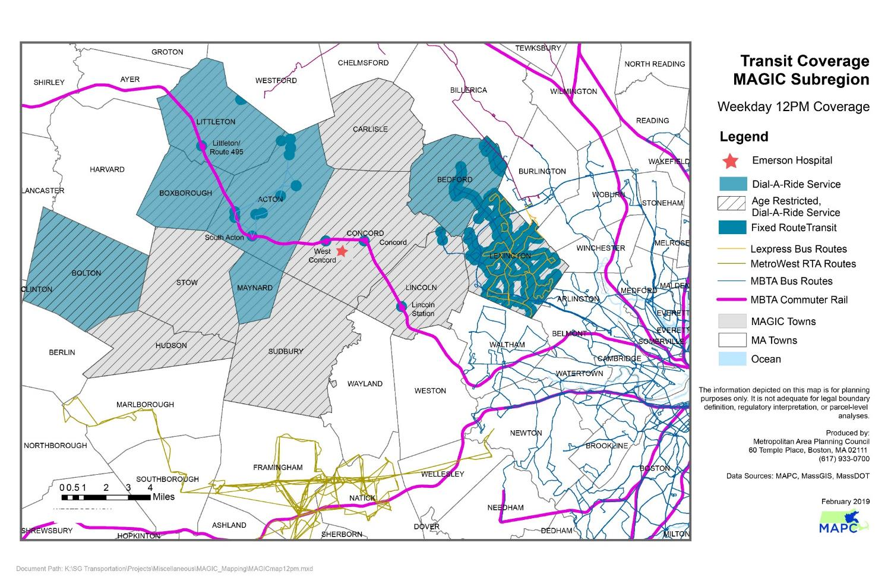
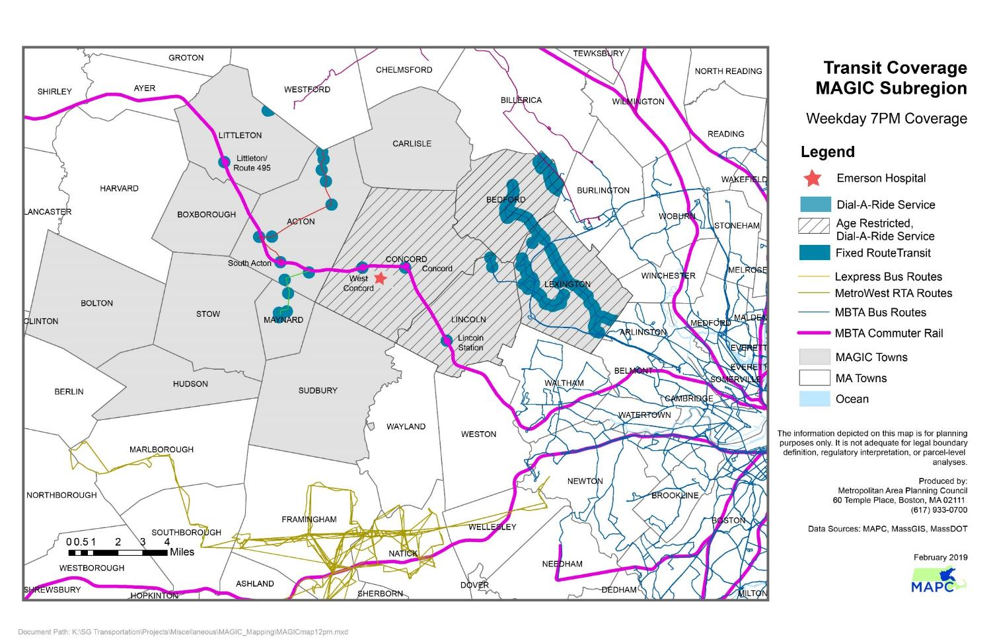
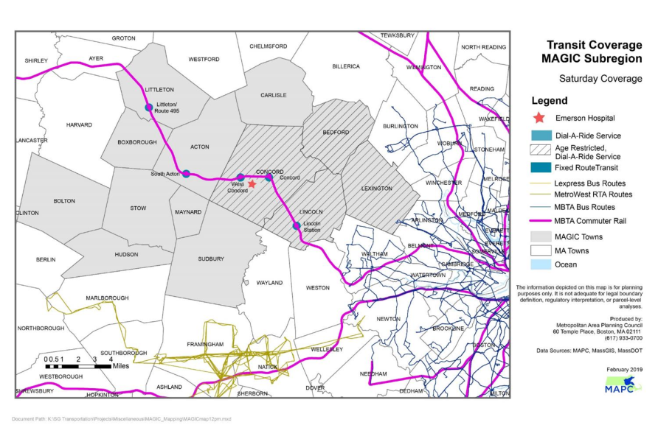
Transit Deserts (MAPC Data)
draft 10/01/2021

Slide 7
Initiatives Underway and Funding
$80,000 Community Compact Cabinet Grant (2019): “Making the Connections”
    Sudbury, Acton, Bolton, Concord, Maynard and Stow; using microtransit to supplement CoA and RTA services (in process)
$23,050 MAPC COVID-19 Emergency Taxi Grant 1 (2020)
  Sudbury contracted with Tommy’s Taxi and JFK Transportation (concluded 2.28.21)
$100,000 MAPC COVID-19 Emergency Taxi Grant 2 (2021)
  Sudbury, Concord, Maynard, Stow contracting with Tommy’s Taxi and JFK Transportation (in process)
$10,000 GoSudbury! Uber Rides Program Pilot (2021)
  Sudbury contracting with Uber as part of Making the Connections
10/1 Speaker note – stress that the large $$$ are shared with other towns
draft 10/01/2021

Slide 8
Focus of Initiatives
Current focus for all transportation initiatives is meeting priority needs. For Sudbury, these are defined as transportation to:
Healthcare and social services,
shopping, community resources, and work.
Residents most in need of such transportation include those:
Over age 50 years
With disability (temporary or permanent)
Veterans
Financially vulnerable
draft 10/01/2021

Slide 9
Data Collected
# of residents registered for Taxi program?
  % 50+
  % With disability
  % Veterans
  % Financially vulnerable
# of residents registered for Uber program?
  % 50+
  % With disability
  % Veterans
  % Financially vulnerable
10/1 Make this Go Sudbury as a whole – we have that data – cut and paste – Alice has the data
draft 10/01/2021

Slide 10
Data Collected
Absolutely, and we need to “show” data on taxi usage, especially during first grant—such as registrants with disability (see my Excel excerpt sent to Doug
Need more data w.r.t. riders w/ disabilities
10/1 Here we want to show the 47% of people signed up for taxi program identified w/ Disability
Avg usage of WAV rides/mo is 6
Alice/Doug will come together ron a graphic to use here
draft 10/01/2021

Slide 11
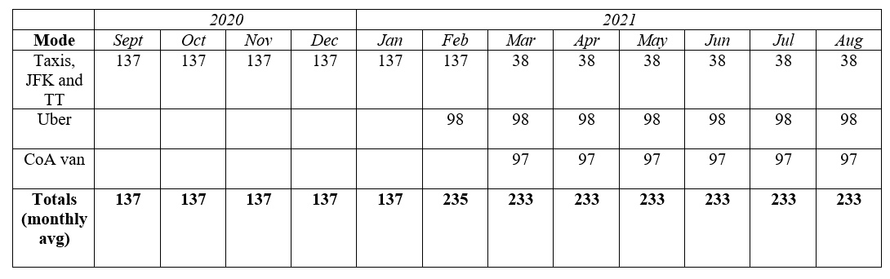
Data Collected
10/1 Alice will put actual #s in here, not averages
Due to pandemic taxis were only mode of transport through Jan 2021
60% of taxi cost paid by MAPC grant; remainder from town mitigation and Baypath grant
Second MAPC grant awarded winter 2021; taxis reduced to medical only rides March 2021
Uber pilot began Feb 2021. Funded from Meadow Walk mitigation
Vulnerable riders triaged to taxis, Uber for medical/healthcare, shopping, work, community resources.
ConA vans started back up March 2021; restricted to 1 person per trip due to Covid. Dial-A-Ride stated back up in June 2021.
Subsidized transportation destinations focused on medical and healthcare, essential shopping, community resources, employment
draft 10/01/2021

Slide 12
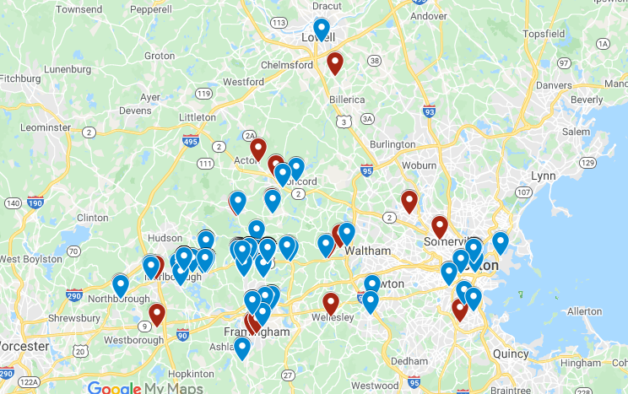
Data Collected
10/1 Dan to see if he can add in the Uber view specific to Route 20 zoomed in!!! Put it in as an insert
Uber data shows consistent patterns and clusters
  Heavy usage up and down Route 20
  Repeat rides to medical appointments, in particular dialysis centers
  Food shopping
  Some longer rides, but majority short distance
draft 10/01/2021

Slide 13
Data Collected
Uber September Rides (9/1-9/28)
Number of rides: 150
Average distance 11 miles
Average ride duration 22 minutes
Average fare $22
Rider qualifying categories
  50+ years = 80 (53%)
  Limited financial means = 27 (18%)
  With disability = 43 (29%)
Healthcare destinations
  Mass General Hospital
  Boston Medical Center
  Emerson Hospital
  Harvard Vanguard/Wellesley
  Dana Farber
10/1 Uber data has become stable and somewhat predicable over time
Speaker notes – highlight healthcare destinations
draft 10/01/2021

Slide 14
Data Collected
Do we want a slide showing financial burndown?
10/1 Dan will take Adam’s financial table and repackage it here…separate out Uber and Taxi…be sure to highlight that the big pots of money were shared
Also – we want to note that taxis are expensive but have been extremely valuable…put here or in lessons learned?
draft 10/01/2021

Slide 15
Accomplishments to Date
Under Accomplishments I think it is important to highlight the tie of transportation to physical health (talk about, for example, trips to dialysis) as well as mental health
Also we were able to provide rides during Covid when other options were not available!
Both excellent points, although prior slide expanded may supplement what we need to put on this slide.
draft 10/01/2021
10/1 If we build out the next slide we can remove this one
DG Note: Use GoSudbury! Name for Taxi program as well as Uber.

Slide 16
Lessons Learned
Data Validates Livable Sudbury Assessment
Livable Sudbury Said…
X
X
We Learned That…
X
X
10/1 Alice will work w/ Sandy to fill this one out
draft 10/01/2021

Slide 17
Lessons Learned
Successes
  We shouldn’t skimp here! Celebrate what we’ve done
  Agreed, and we need to be clear in how we define success. I believe we reached and are reaching most of the most needy (frail, disabled, older, poor). We provided a huge number of rides in comparison to what was available. We demonstrated what the priority needs are, and who needs them most.
Sudbury as a Model/Leader
  Here I think we should mention that others in the Region *and State* are looking to what we are doing and modelling their behavior after ours
  Lead Community…. I like this, especially after hearing that we were among a relatively small number of communities doing the first MAPC grant. And, we are a model for a rural-suburban region with multiple RTAs and little MBTA services. The challenge is a national one: public/mass transit cannot be efficiently expanded to areas like ours, and communities like us are pushed to demonstrate what can work (e.g., Newton with Via, Lexington, etc.)
Tie to Livable Sudbury survey – I think we can show that our data validates it!
  I think we can prove there is a need! Thank you for keeping this front and center!
10/1 Turn this into a slide of feedback we have received form riders e.g. “…it saved my life…”
Alice/Sandy will work on this
draft 10/01/2021

Slide 18
Lessons Learned
Pitfalls/Gaps
  We address ONLY the top priority destinations for the most needy. Transportation is important for so many more residents. The Livable Sudbury assessment found:
Transportation is identified as crucial by a wide range of stakeholders:
  Families with children under 18 years
  Residents age 60+
  Residents of all ages with a participation limitation
  Residents of all ages who are not financially secure.
High prevalence of calls for those with disabilities; Not only wheelchairs but cognitive, visual, and other impairments
Dependence on outside funding (we had to shut down the Taxi program); equally as important, we spent twice as much as MAPC awarded, and we should be proud of that
Awareness of program? Multiple channels used but were they the right ones?
Environmental impact – opportunity to improve situation?
draft 10/01/2021

Slide 19
Target State: Sustainability
2019 Livable Sudbury needs assessment: Transportation is the town’s biggest challenge.
Sudbury now at crucial stage:
  Is there Town commitment to a sustainable, effective, and efficient system of transportation for residents?
  If yes, how do we ensure a sustainable, effective, and efficient system of transportation for residents?
draft 10/01/2021

Slide 20
Target State: Sustainability
From Mission Statement crafted by Select Board: ”It is envisioned that the Committee’s purpose and tasks will become part of the responsibilities of town departments or bodies at some future date. “
To date majority of work done by Committee; inefficient, not able to react quickly
Need to coordinate wide range of stakeholders
Program Management and Oversight provided by mix of Planning Department, Senior Center, and Committee supported by outreach from Social Worker
draft 10/01/2021

Slide 21
Target State: Sustainability
Program Requirements are Significant
Management:
Grant writing and management
Oversight of Grants
Financial Aspects of Grant Management
Relationships/communications with vendors, Grant providers, other collaborating towns
Data gathering and Reporting on Services provided
Coordination:
Day to Day work with participants in the program
Technical assistance with registration, application, use of service (Taxi dispatch, Uber smartphone app)
Education to users about all transportation options
Referral to Uber Tech help volunteers
Troubleshooting when there are issues
draft 10/01/2021

Slide 22
Target State: Sustainability
Program Requirements are Significant
Making the Connections Community Compact
Regional meetings organized by Sudbury as lead town of 6 towns
Communication with other town leadership/planning
Communication with Project manager
Implementation of RFP for Project manager, etc.
Reporting to Town and Other Entities on Services Provided
MAPC COVID-19 Urgent Taxi Grants 1 and 2
Taxi Company relations
Creation of online application and database
Management of online database
Client relations and tech assistance
draft 10/01/2021

Slide 23
Target State: Sustainability
10/1 Speaker Notes – other towns are ‘struggling’ – we are 2-3 years ahead
Also note time spent outside of committee spent here!
Program Requirements are Significant
GoSudbury! Uber Rides Program Pilot
Uber Contract management
Creation of online application and database
Management of online database
Client relations and tech assistance
Uber user contact re: technical assistance, trouble shooting, access for visual or other impairment issues
Education about transportation options
Other
Senior Center has two van drivers who provide the Sudbury Connection van service
Senior Center provides the Sudbury Connection van service in conjunction with the MWRTA
draft 10/01/2021

Slide 24
Target State: Sustainability
10/1 Sandy and Deb to meet on this one!
Transition here to Deb’s research on what other towns are doing w/ Transportation Coordinators
From Mission Statement crafted by Select Board: ”It is envisioned that the Committee’s purpose and tasks will become part of the responsibilities of town departments or bodies at some future date. “
Transportation Coordinator – Deb gathering data from other towns…insert something here
Could use part of their time to look for funding (State, other grants)
Act as central conduit for Transportation matters
What is goal of this slide? Should we try to define personnel; e.g., Acton, Newton or Lexington models? Should we describe briefly how other towns have addressed transportation?
draft 10/01/2021
DG Notes: I will submit more info on this. I just had a talk with Newton today. I think the Select Board will be looking for concrete recommendations…? Hope to send more info tomorrow (9/28)

Slide 25
Thank you & Questions
draft 10/01/2021

Slide 26
Appendix
Do we want to talk about the changing/growing Sudbury?
Population rose 7.2% 2010 vs 2020
# housing units rose 10.2% 2010 vs 2020
The town is close being built-out, but there are age-restricted and affordable developments such as Quarry North that can have big impact. The issue your raised is sure to be questioned by SB, so let’s meet that head on…
draft 10/01/2021

